Slide 1

How to Make Appointment

Slide 2
Background information 1
The scheduling of appointments, the scheduling of daily activities and the economical management of time are very important in Western culture. There is often an urgency in long-term and short-term planning. To do something on short notice, though possible, is often considered unprofessional.

Slide 3
Analyze the following situation
Zhang has an American teacher, Mr. Welch, whom he has seen and chatted with a number of times on campus. For the last several times, at the end of the conversation Mr. Welch has said, “Come over and see me sometime.” So, one evening Zhang decides to go and visit. He finds the teacher’s appointment and knocks on the door. However, when Mr. Welch opens the door, he doesn’t look very happy to see Zhang.

Slide 4
Questions:
How do you think Zhang might feel when he sees that Mr. Welch looks unhappy?
Why do you think Mr. Welch doesn’t look happy? Should he at least pretend to bee pleased to see Zhang?
In Chinese culture, is it always necessary to arrange a time with someone before visiting? Are there circumstances under which such an appointment is unnecessary?
Do you think Mr. Welch’s invitation is a solid invitation (a serious one) or a polite invitation (a vague one)? How do the Chinese give “polite invitation” and “solid invitation” to others?

Slide 5
Background information 2
Many professionals rely on secretaries to make, confirm, and screen appointments. Often appointments will be made on the phone by talking with the secretary of the person you want to meet.
Watch the video and fill in blanks.

Slide 6
Background information 3
All appointment should be double-checked
for accuracy. The time, location, names of
involved parties, and spelling and pronunciation
of the names should be verified.

Slide 7
Practice 1
Work out replies or questions
Q:
A: I think that would be fine.
Q:
A: I think that a meeting tomorrow during lunch is a
great idea.

Slide 8
Practice 1
Work out replies or questions
Q: When can we meet?
A:
Q: Are you busy Wednesday afternoon?
A:
Q: Do you want to do lunch?
A:

Slide 9
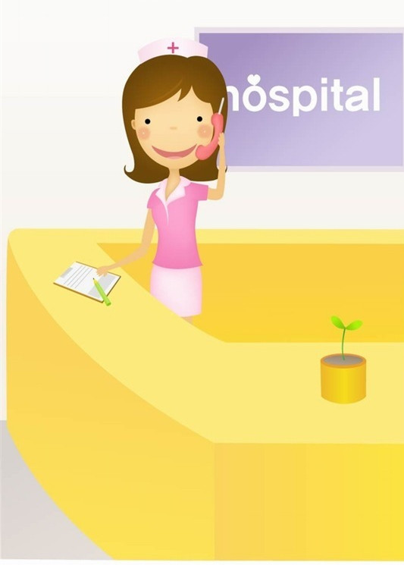
Practice 2
Work out dialogues
Mr. Murphy, a businessman, wants to set up an appointment with his doctor named Dr. Bailey. He speaks with the receptionist named Mary.

Slide 10
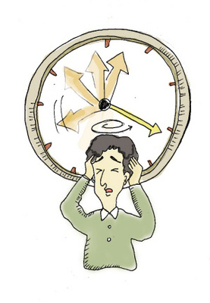
Practice 3
A month ago you made an appointment with Professor Wilson to discuss important research plans. Professor Wilson has a very busy schedule.
Unfortunately, you need to see a dentist at the same time as your appointment with Professor Wilson. What can you do? Please make up a dialogue with Professor Wilson or with the dentist to cancel or reschedule your appointment.

Slide 11
Free Talk
What do you usually do on holiday?
Do you like traveling?
Where would you go if you had time to go on a trip?
Will you go with other people or travel alone?
What do you like to do during a trip?
What is the most unforgettable experience of your recent trip?

Slide 12
Diagram
Text
Text
Add Your Title
Text
Text

Slide 13
Diagram
Add Your Text
Add Your Text
Add Your Text
Text
Add Your Text
Add Your Text
Add Your Text

Slide 14
Diagram
Add Text
Add Text
Add Text

Slide 15
Diagram
2001
2002
2003
2004
Your Text
Your Text
Your Text
Your Text
Your Text
Your Text
Your Text
Your Text

Slide 16
Progress Diagram
Phase 1
Phase 2
Phase 3

Slide 17
Block Diagram
TEXT
TEXT
TEXT
TEXT
TEXT
TEXT
TEXT
TEXT

Slide 18
Table
Text
Text
Add Your Text
Text
Title
Text
Text
Text

Slide 19
3-D Pie Chart
TEXT
TEXT
TEXT
TEXT
TEXT
TEXT

Slide 20
Diagram
1
2
3
ThemeGallery is a Design Digital Content & Contents mall developed by Guild Design Inc.
ThemeGallery is a Design Digital Content & Contents mall developed by Guild Design Inc.
ThemeGallery is a Design Digital Content & Contents mall developed by Guild Design Inc.

Slide 21
Thank You !
Add your company slogan

